Slide 1
SALGA’s PERSPECTIVE ON POWERS AND FUNCTIONS
MINISTER OF WATER AND SANITATION INTERACTIVE SESSION WITH WATER SERVICES AUTHORITIES
25 JAN 2019

Slide 2
CONTENT
Context
Our perspective
Recommendations

Slide 3


It’s not about powers and functions only
Section 152 of the Constitution
Municipal council must strive within its capacity to achieve its objectives:
  Provide democratic and accountable government for local communities;
  Ensure the provision of services to communities in a sustainable manner;
  Promote a safe and healthy environment;
  Promote social and economic development;
  Encourage the involvement of communities and community organisations in matters of local government

Slide 4
SERVICE DELIVERY IMPROVEMENT

Slide 5
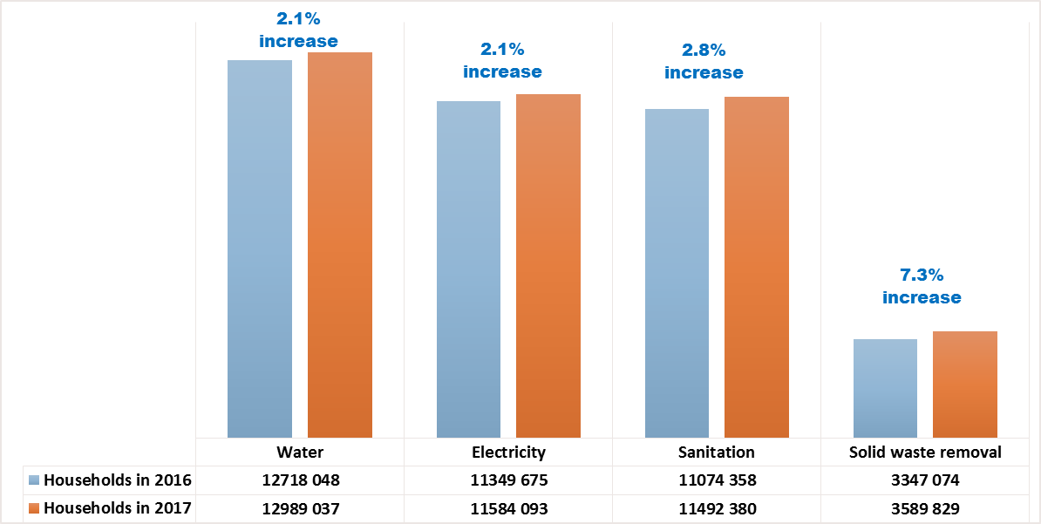
HOUSEHOLD ACCESS TO FREE BASIC SERVICES
Year on year increase in the number of households with access to services, particularly in solid waste removal (7.3% increase)

Slide 6
How would you describe the municipality's water and sanitation service in the area where you live?

Slide 7
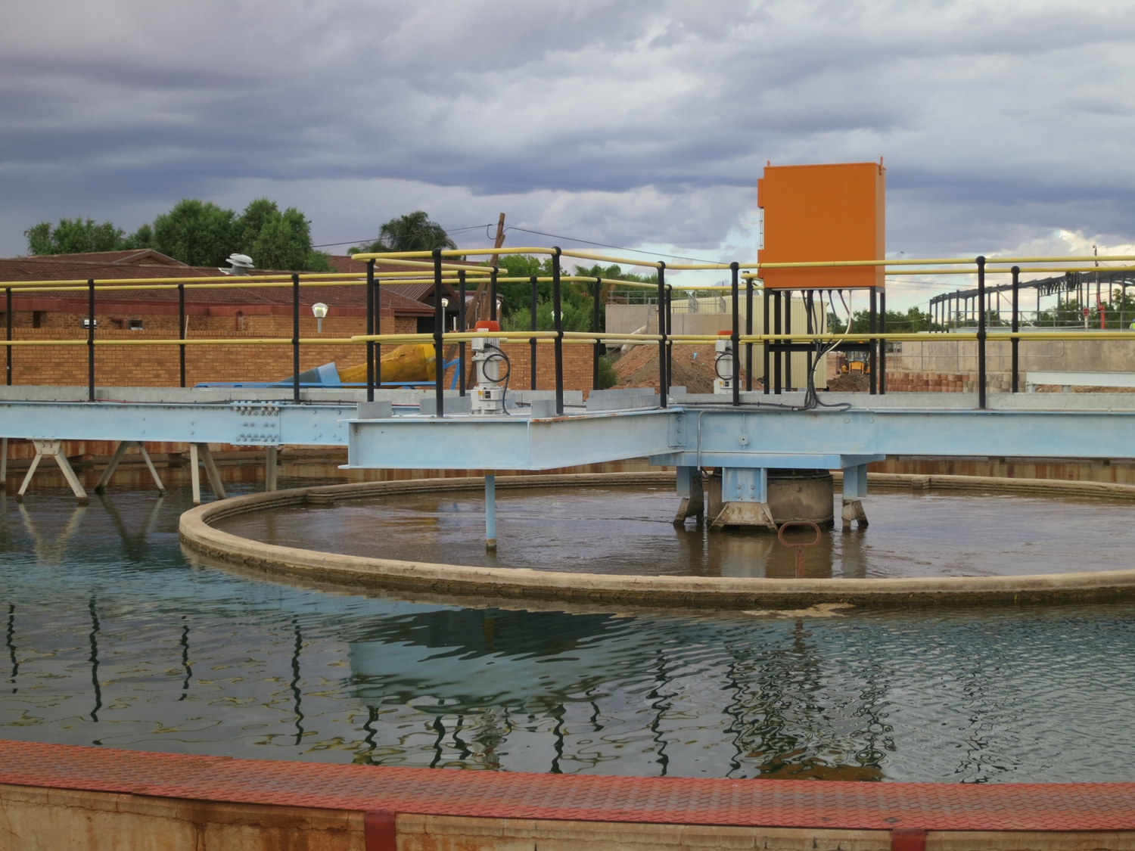
Product Quality
2011
81% of South Africans believed their tap water is safe to drink
2015
88% of South Africans believed their tap water is safe to drink
Source: SALGA/WRC perception study 2015

Slide 8
GEOGRAPHICAL LOCATION OF WATER SERVICES AUTHORITIES

Slide 9
SOUTH WATER SERVICES AUTHORITIES
LIMPOPO
 | EC | FS | GP | KZN | LP | MP | NC | NW | WC
Category A Metros | 2 | 1 | 3 | 1 |  |  |  |  | 1
Category B Locals | 9 | 19 | 6 | 3 | 7 | 18 | 27 | 11 | 24
Category C Districts | 5 |  |  | 10 | 4 |  |  | 2
Total | 16 | 20 | 9 | 14 | 11 | 18 | 27 | 13 | 25
DMs and LMs
5.8M
GP
13.4
MPUMAL-ANGA
Lms and DMs
4.3 M
NORTH WEST
DMs and LMs
3.7M
KWAZULU
NATAL
Lms, Dms and Metro
11.M
FREE STATE
Lms , DMs and Metro
2.8M
NORTHERN Cape
LMs
1,2 M
EASTERN Cape
Dms, LM and Metros
7M
WESTERN CAPE
Lms, DMs and Metro
6.3M

Slide 10
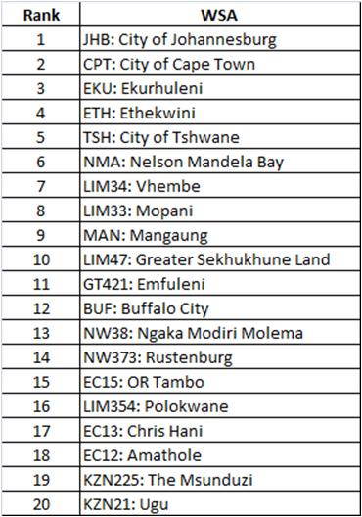
Service Challenge (h-holds served)

Slide 11
FUNDING AND FINANCING
OF INFRASTRUCTURE

Slide 12
Funding mix for social and
economic infrastructure (4Ts)
Transfers
(equitable share and grants)
Trading (Resource Recovery Bio Gas
Taxes (property rates)
Service Charges
Infrastructure Development and Management including operations and maintenance

Slide 13
INFRASTRUCTURE MANAGEMENT

Slide 14
Water Services Trajectory
Majority of Water Services Authorities are 16 years of Age – Further most of them were new in the business and without any mentoring and parenting
16 years in the water business
2006
2011
2016
2021
2003 - Powers and Functions

Slide 15
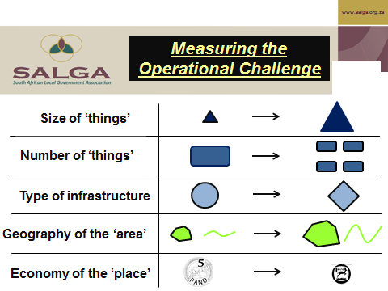
‘Easier’ ‘Harder’

Slide 16
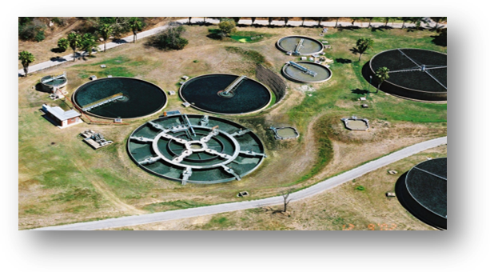
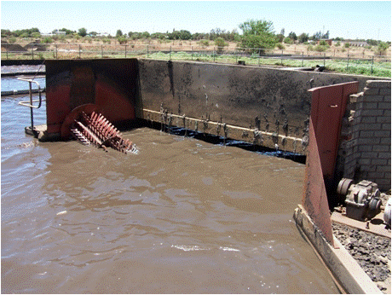
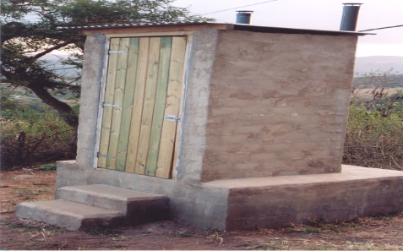
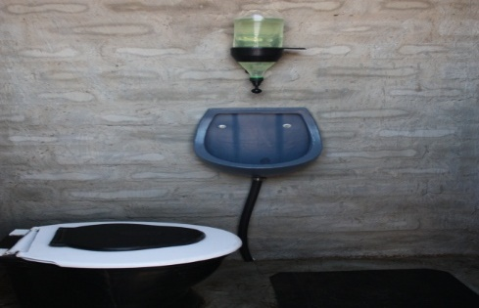
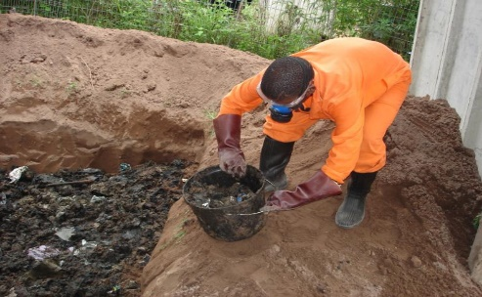
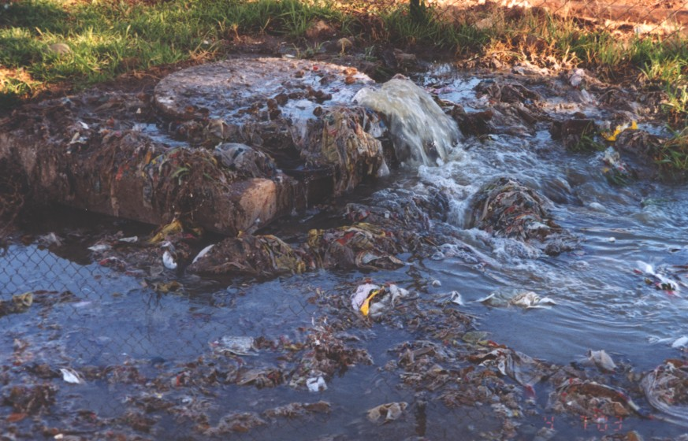
What are we Managing
Wet
Sanitation
Most facilities were found to have operational problems
Dry
Sanitation
Dry sanitation O&M problem has not even been seen yet
Example: 36000 VIPs over 3yrs at between R900 – 1200 p/VIP
Good
Bad
Ugly
Good
Good
Ugly

Slide 17
ALTERNATIVE SERVICE DELIVERY MECHANISMS

Slide 18
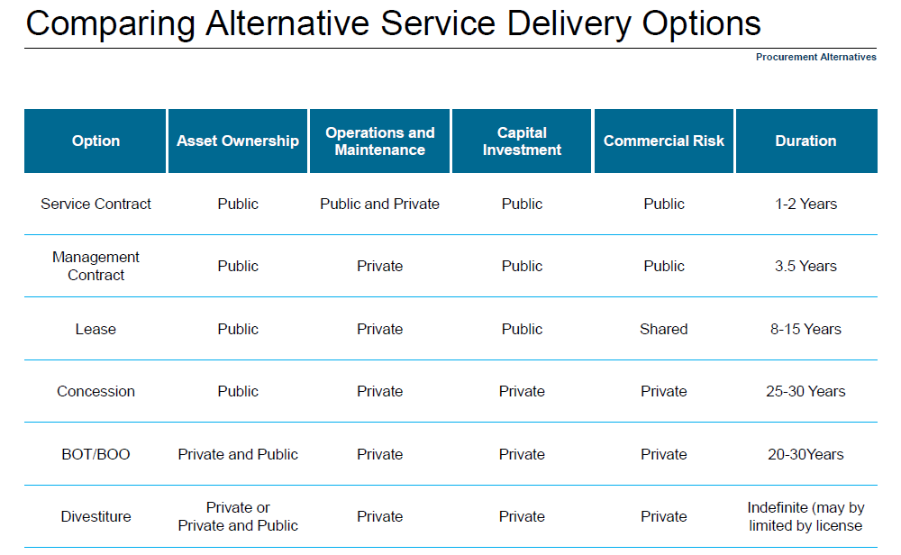
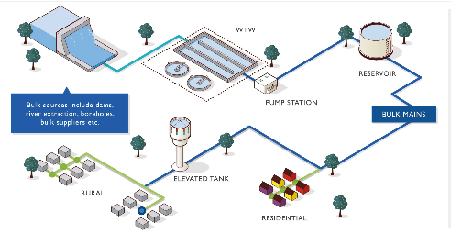
INFRASTRUCTURE DEVELOPMENT AND MANAGEMENT
Content Courtesy of Barclays

Slide 19
Examples
 | WSA | Province | Delivery Mechanism | WSP
Category A Municipalities
1 | City of Joburg | Gauteng | External | Joburg Water Pty Ltd
2 | City of Cape Town | Western Cape | Internal
Category B Municipalities
3 | Mangaung | Free State | Internal and external | Bloem Water
4 | Mbombela | Mpumulanga | External and Internal | Silulamanzi
Category C Municipalities
5 | Chris Hani DM | Eastern Cape | External | Local Municipalities
6 | Ilembe DM | KZN | Mix of Internal and External | Concession

Slide 20
POPULATION GROWTH AND ECONOMIC OUTLOOK

Slide 21
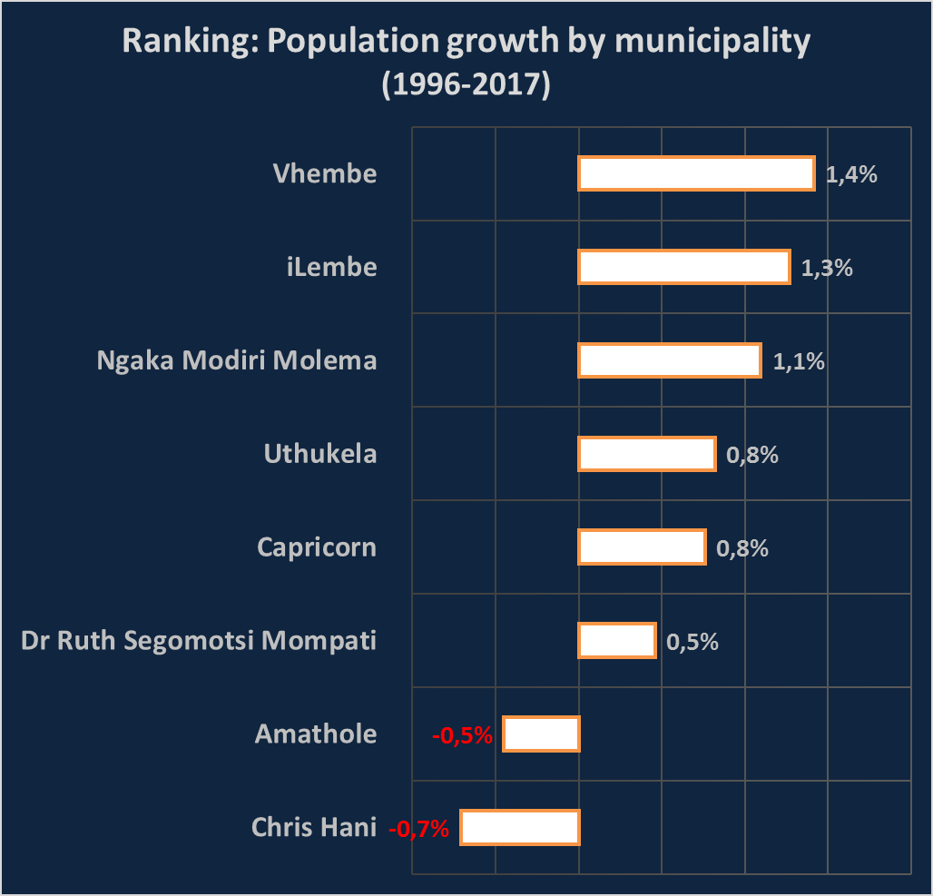
POPULATION TRENDS (Comparing with Water Services Authorities)
Vhembe’s population grew the fastest over the past 21 years.
The opposite is true for Amathole and Chris Hani

Slide 22
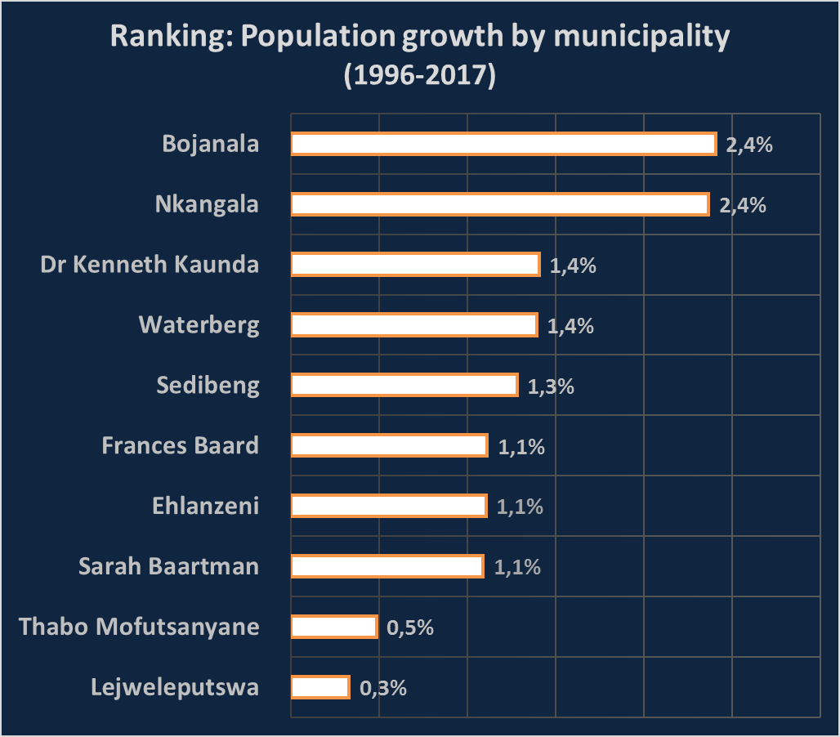
POPULATION TRENDS (Comparing with other Districts)
Bojanal’s population grew the fastest over the past 21 years.

Slide 23
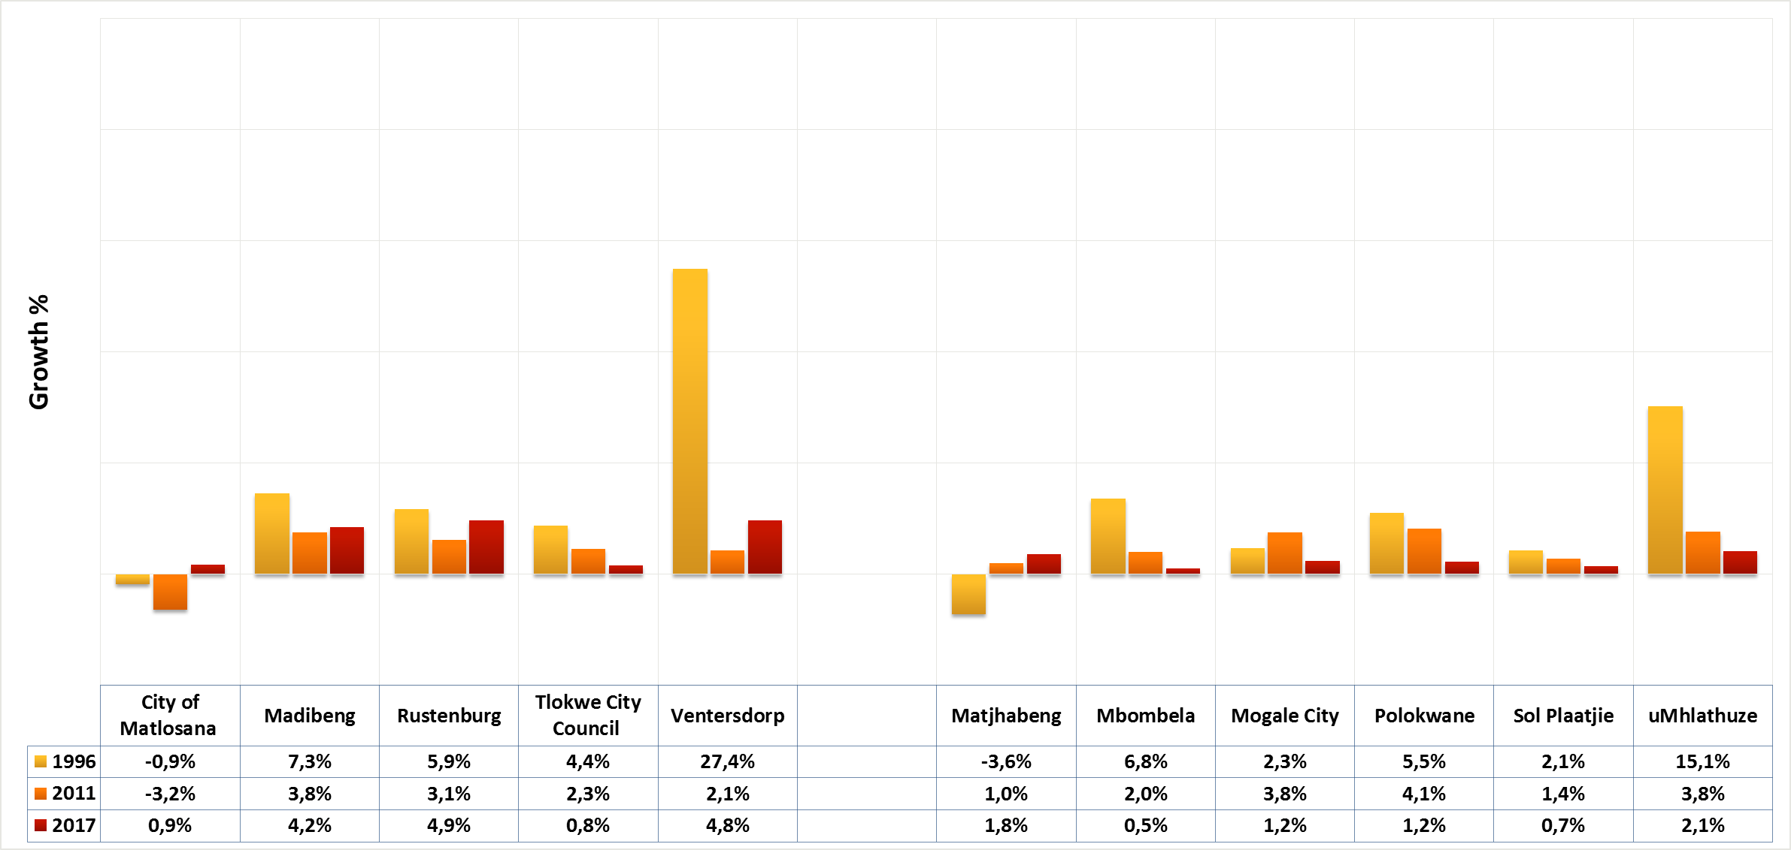
ECONOMIC PERFOMANCE (comparing with Cities)
Avg growth (1996-2017)
-2.0%
3.1%
2.0%
2.1%
3.5%
-0.3%
2.8%
3.0%
3.6%
1.9%
3.2%
Avg growth (2011-2017)
-1.0%
1.5%
0.2%
1.5%
1.5%
1.1%
1.6%
2.0%
2.3%
1.2%
2.0%

Slide 24
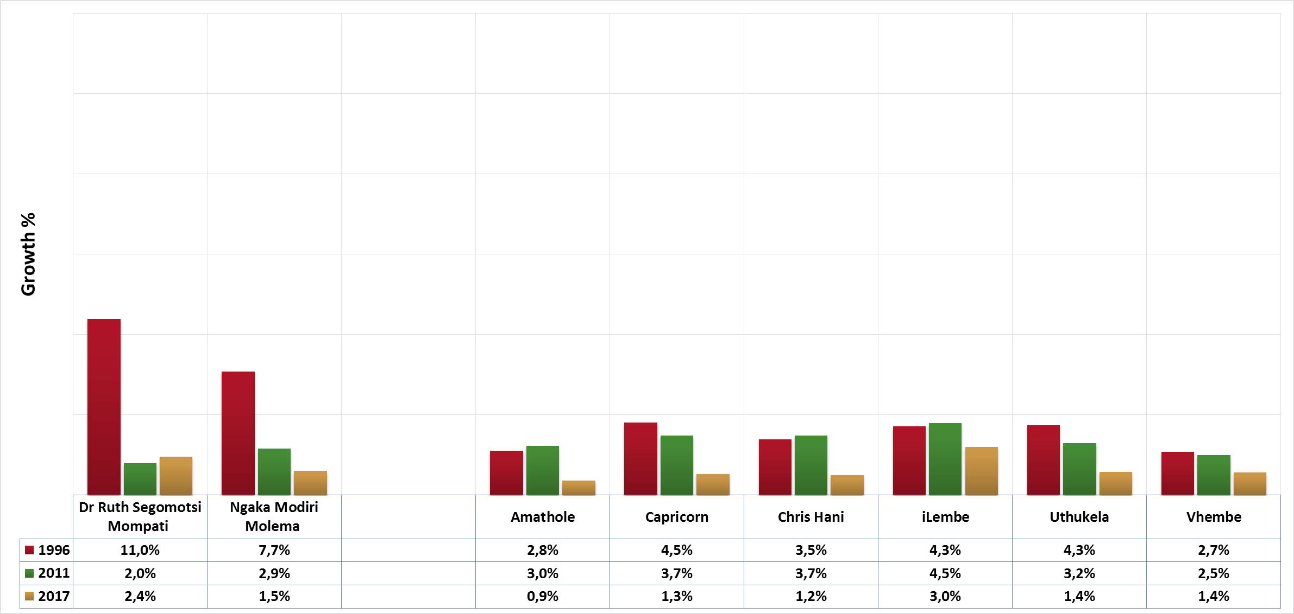
ECONOMIC PERFOMANCE (comparing with Water Services Authorities)
Avg growth (1996-2017)
2.5%
1.4%
2.2%
3.3%
2.6%
3.5%
2.8%
2.8%
Avg growth (2011-2017)
2.7%
2.0%
1.5%
2.1%
2.0%
2.9%
1.8%
1.5%

Slide 25
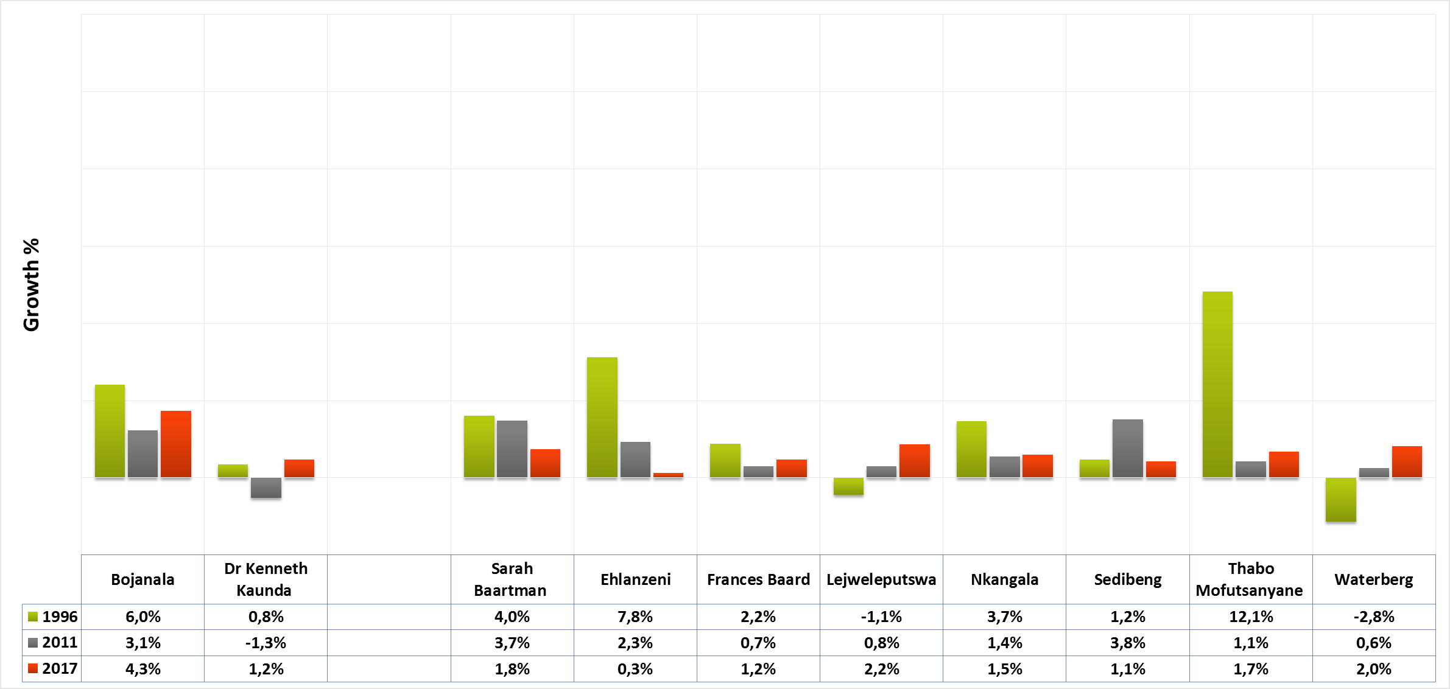
ECONOMIC PERFOMANCE (comparing with other Districts)
Avg growth (1996-2017)
2.2%
-0.8%
2.7%
2.5%
1.9%
0.1%
2.4%
2.2%
2.3%
2.0%
Avg growth (2011-2017)
0.5%
0.0%
1.9%
1.7%
1.1%
1.1%
1.3%
1.5%
1.1%
0.9%

Slide 26
OVERALL MANAGEMENT AND SYSTEMS

Slide 27
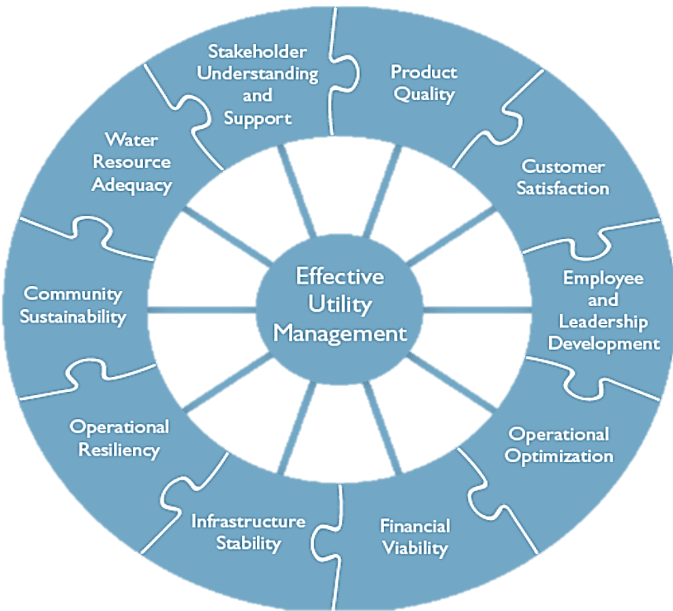
Understanding the business model

Slide 29
INFRASTRUCTURE DIVERSITY WITHIN THE MUNICIPAL AREAS OF JURISDICTION

Slide 30
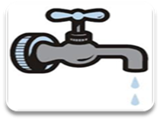



Cost of Service vs Equitable Share
R359,04 per household per month for a package of free basic services
Free basic services
R41 billion
Water and Sanitation R24 billion
10% Is for Maintenance R2,4B for Water and Sanitation

Slide 31
SUGGESTED WAY FORWARD
(1) Regulation and oversight
  Explore munics to be local regulators in certain Geographical spaces
  Common by laws for the water sector
  Common Credit Control Mechanism(s)
  Independent Regulator - monitoring and evaluation
(2) Service Delivery Mechanism and Management
  Rationalisation and Consolidation across the value chain
  Explore Private and Public sector participation
(3) Infrastructure Development and Financing
  Special Purpose Vehicles for infrastructure development (Bulk vs retail)
  Development of National, Provincial and local Infrastructure Investment Policy
  National vs Regional vs Local Costing Pricing Regime
(4) Infrastructure Planning
  Explore the establishment of Water and Sanitation Planning Commission
    Coordination of infrastructure planning

Slide 32

THANK YOU
William Moraka
wmoraka@salga.org.za
082 308 5519

